Slide 1

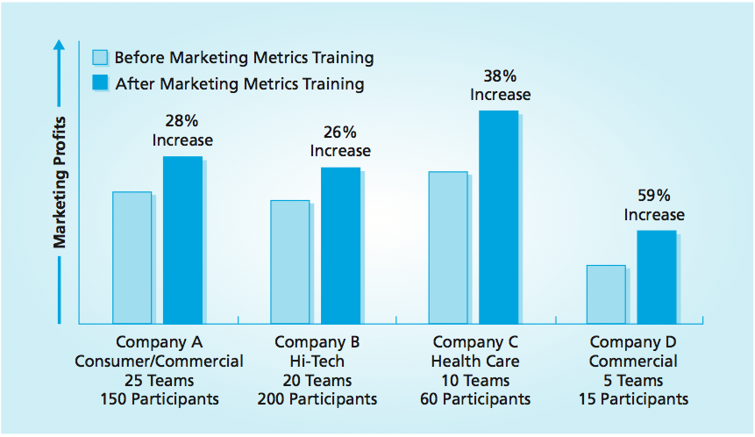
Marketing Performance Metrics
MBM6
Chapter 15
Chapter 15 Objectives
Barriers to Getting Started Using Marketing Metrics
Forward-Looking vs. Backward-Looking Metrics
Successful Strategy Implementation
Variance Analysis
■ If you can’t measure it, you can’t manage it. —from The Balanced Scorecard
by Robert Kaplan and David Norton, Harvard Business School Press, 1996
Copyright Roger J. Best, 2012
Notes:
The four companies in the graph are Fortune 500 companies that participated in a marketing metrics training. The graph shows the improvement in marketing profitability (net marketing contribution) the companies could achieve if they successfully implemented the marketing metrics that the teams applied. Performance would improve an average of 32 percent. Because these are large companies, the average gain in marketing profits would be over $5 million.

Slide 2

Marketing Metrics Solutions
MBM6
Chapter 15
Marketing Metrics Resources
White Paper – Getting Started Using Marketing Metrics
Marketing Metrics Blogs - Advanced Application and Best Practices
Available at www.marketingmetricssolutions.com
Copyright Roger J. Best, 2012

Slide 3
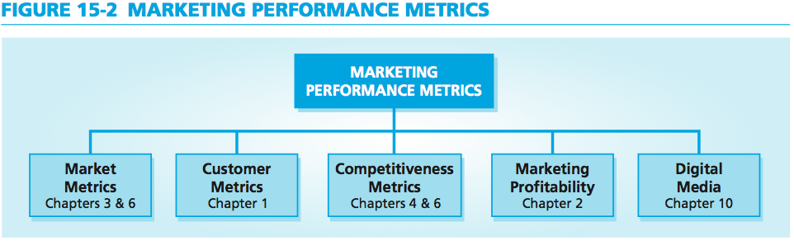
Marketing Performance Metrics
MBM6
Chapter 15
Businesses are obsessed with financial results because they tell what has happened. But rarely do businesses fully understand all the reasons for their financial results.
Marketing performance metrics measure the factors that are actually driving profits in the market.
Copyright Roger J. Best, 2012

Slide 4
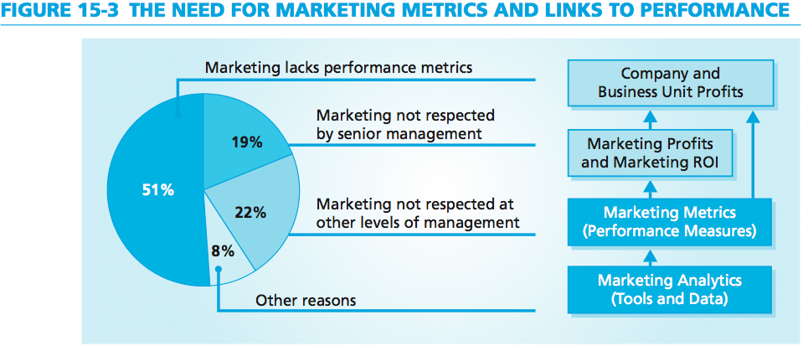
Need for Marketing Performance Metrics
MBM6
Chapter 15
Barriers to Getting Started Using Marketing Metrics
They are too complex and too difficult to use.
They do not solve my business’s problems.
There are too many; I don’t know where to start.
I do not have the data nor the budget to gather the data.
I do not have the time for this type of work.
Copyright Roger J. Best, 2012
Notes:
Booz-Allen Survey

Slide 5
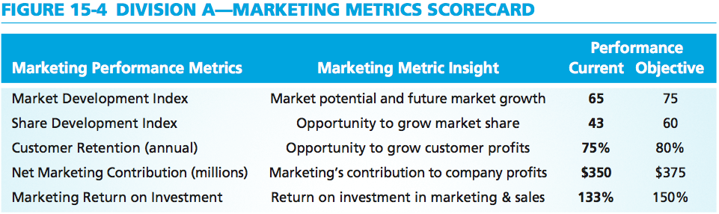
Marketing Metrics Scorecard
MBM6
Chapter 15
Marketing managers of a large chemical company decided to start with the three metrics that had the most meaning for the company and that would be easy to present to management as credible measurements.
Copyright Roger J. Best, 2012

Slide 6
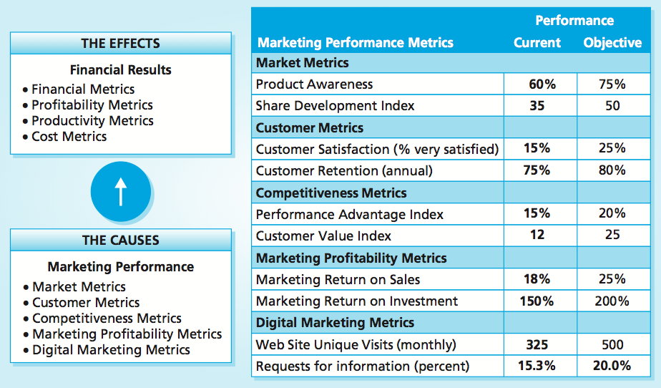
Marketing Performance Scorecard
MBM6
Chapter 15
Copyright Roger J. Best, 2012
Notes:
Manager insights, experience, and intuitions are a good place to start and require no budget. As shown in Figure 15-5, manager insights and “best estimates” are a satisfactory beginning. Marketing managers need to overcome their fear of using imperfect data. They should feel comfortable estimating the data needed for any marketing analytic. The data can easily be revised with team consensus or if market research uncovers more accurate information. Marketing analytics provide a way to capture the collective thinking of a marketing team. Data validation can follow if needed and important.

Slide 7
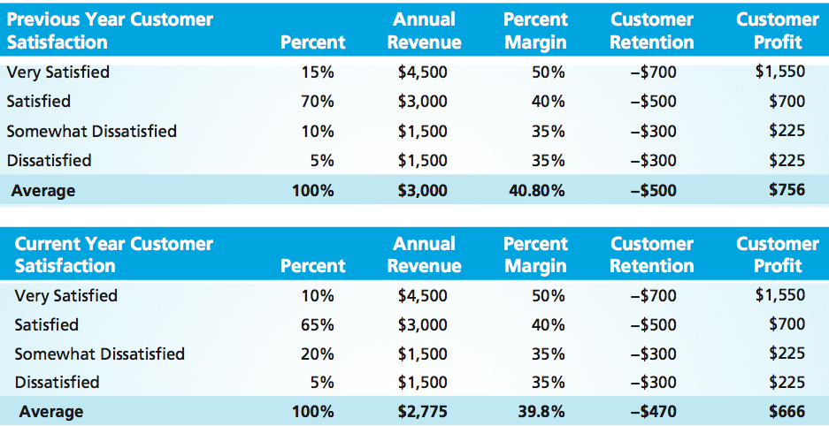
Customer Satisfaction – Forward-Looking
MBM6
Chapter 15
Businesses that effectively use measures of customer satisfaction have a forward-looking metric that enables them to take corrective action in time to avoid a negative impact on financial performance.
Copyright Roger J. Best, 2012

Slide 8
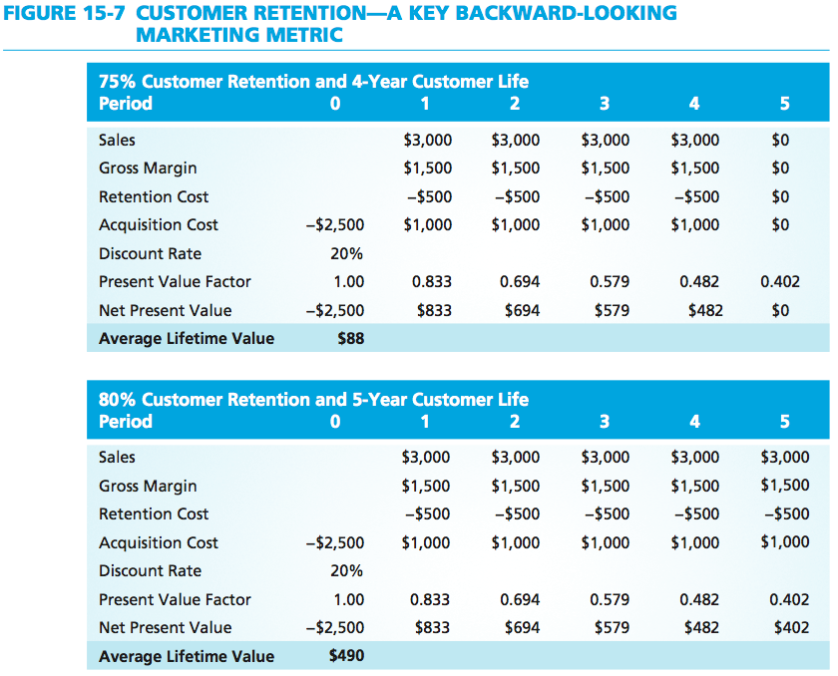
Customer Retention – Backward-Looking
MBM6
Chapter 15
The average customer lifetime value with an 80 percent customer retention increases to $490, five and a half times more with the same 20 percent market share.
Copyright Roger J. Best, 2012

Slide 9
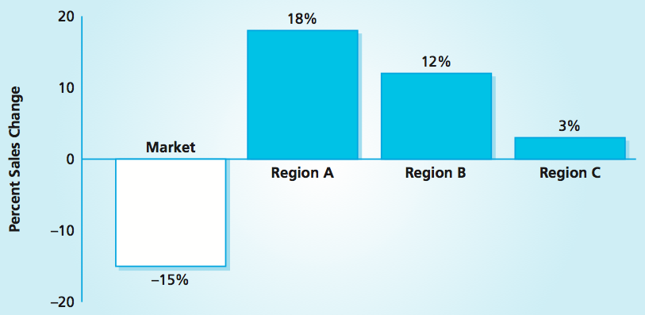
Sales Impact of Successful Strategy
MBM6
Chapter 15
What should have been done to avoid the lack of aligned execution that this business suffered in the implementation of their marketing strategy?
Copyright Roger J. Best, 2012
Notes:
To implement this strategy successfully, the marketing manager had to sell it to the three regional vice presidents for sales. Two regional sales VPs agreed to implement the strategy, but the third chose not to participate. The results, shown in Figure 15-8, illus- trate the importance of effective strategy implementation. In the two regions (A and B) where the marketing strategy was implemented, sales increased by 18 and 12 percent, even though total demand in the market declined by 15 percent. By contrast, the region (C) that did not implement the marketing strategy had only a 3 percent sales gain.

Slide 10
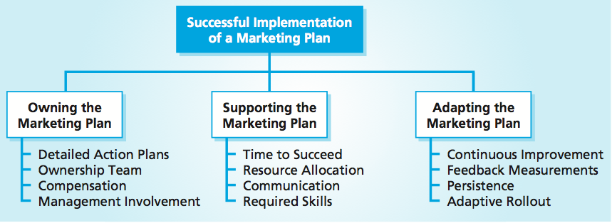



Successful Plan Implementation
MBM6
Chapter 15
Copyright Roger J. Best, 2012

Slide 11
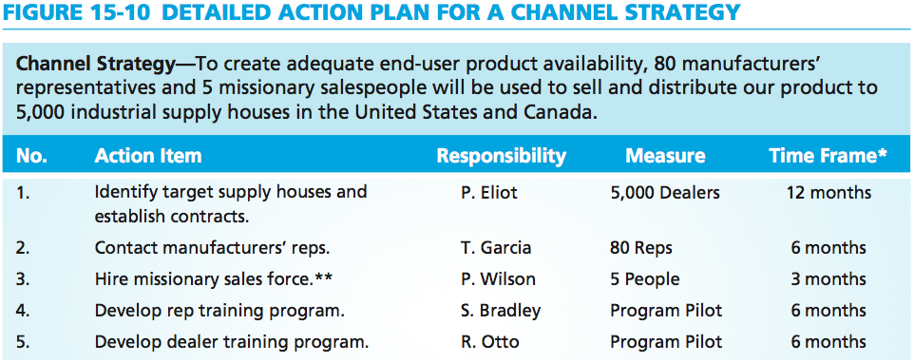
Action Plan for Channel Strategy
MBM6
Chapter 15
When individuals take ownership of particular aspects of the process, a business breaks the business-as-usual routine, creating an environment that fosters successful implementation of the plan.
Copyright Roger J. Best, 2012

Slide 12
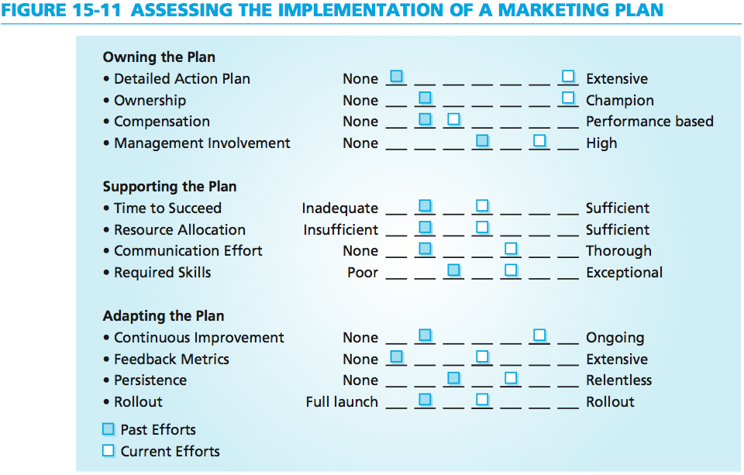
Assessing Plan Implementation
MBM6
Chapter 15
A good marketing plan with this level of implementation effort will enable a business to achieve its desired level of performance within the timeframe allotted.
Copyright Roger J. Best, 2012

Slide 13
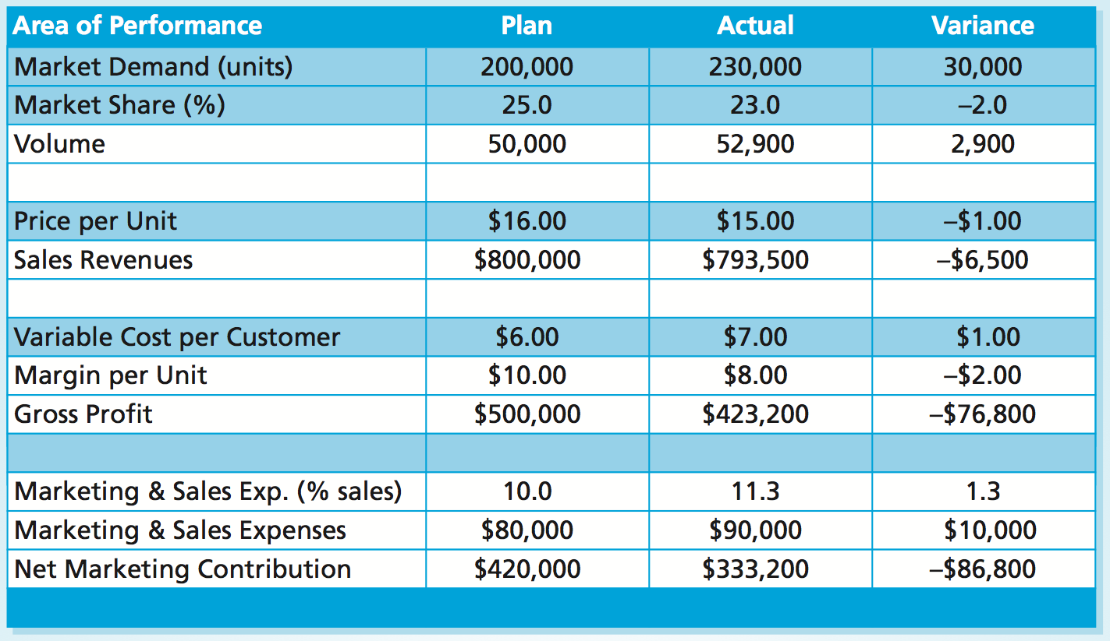
Marketing Performance Tools 15.1-15.3
Variance Analysis
MBM6
Chapter 15
The actual NMC at the end of year 1 was $86,800 less than estimated in the plan. What was the primary cause of this shortfall in performance?
Copyright Roger J. Best, 2012

Slide 14
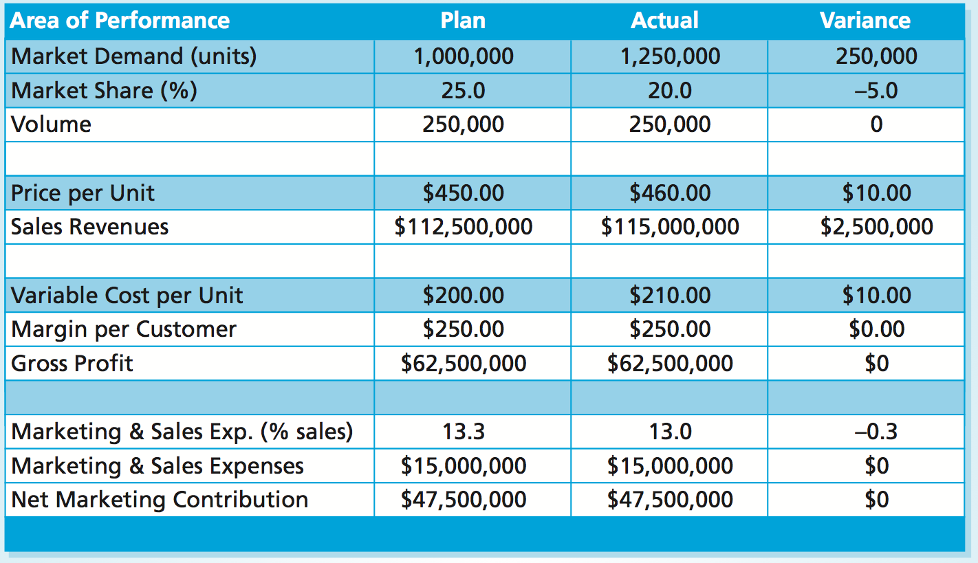
Marketing Performance Tools 15.1-15.3
Variance Analysis
MBM6
Chapter 15
A business that does not track marketing performance metrics will usually discover too late that its marketing plan is not working. What does the analysis above reveal?
Copyright Roger J. Best, 2012

